Slide 1

TriNetra
Team Members: 1. MatThew Schenk
2. Anusha Karnati
3. Sai Kishan Naraparaju

Slide 2
outline
Need for this Project
Required Features
Use Cases
Project Organization
Development Method
Resources
Schedule
User Interface
Navigation
Data Storage

Slide 3
Description of problem
Currently the User documents their tasks in a small notebook.
Enable User to keep record of tasks in an e-format accessible on a tablet
This application will to store these tasks and information associated with it.
Quick search for specific tasks by entering any of the task information allows quick access to the user.
It allows the user to search for an event of a certain type, name, or timespan and displays the results.

Slide 4
Features
This application must allow the user to add a task and search for a task.
Add Task allows to select a person, or multiple persons or organizations to be associated with the task, then able to select the type of the task and enter a comment associated with it.
This information along with the current time and date will be captured and stored to the device.
Since this is a stand-alone application, the information will be stored on the device’s local storage. This helps ensure security.
Utilizing the space, a feature to delete by date will most likely be important as years of tasks start to accumulate and should be added.

Slide 5
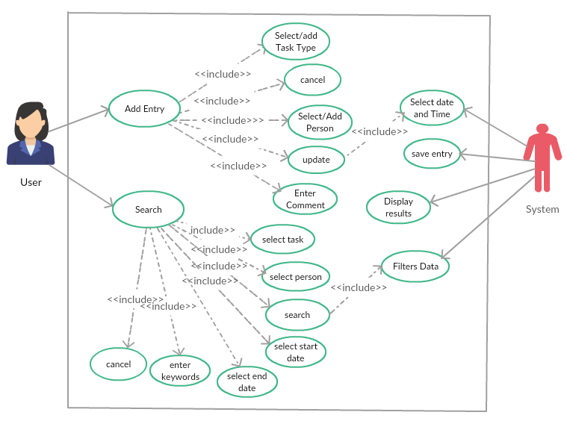
Use Case Diagram

Slide 6


Project Organization
Democratic Decentralized Structure
Management Reporting

Slide 7
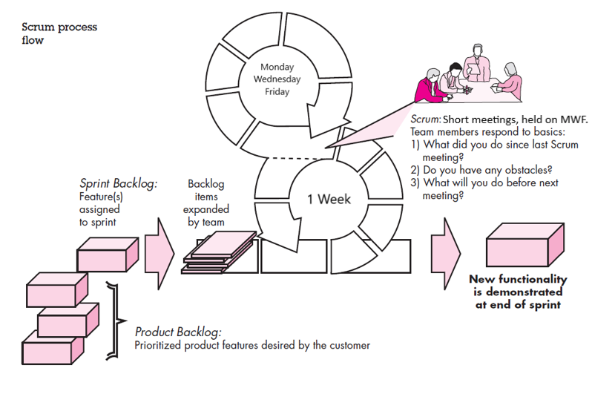
Developmental Methodology: Scrum Method

Slide 8
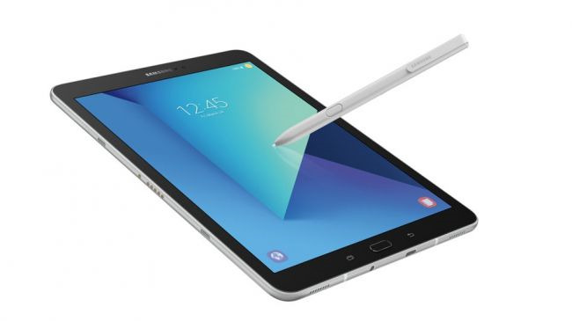
Resources
Personnel
Customer
Consultants
Hardware
Samsung Galaxy Tab S3
Software
Apache Cordova
Ionic Framework
JavaScript

Slide 9
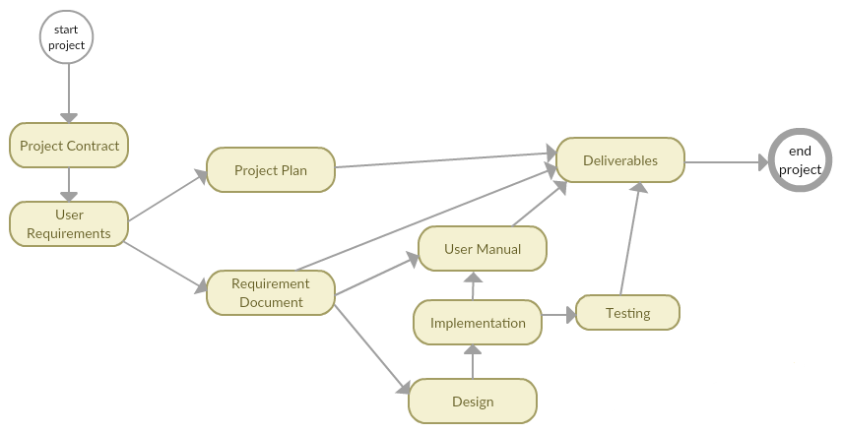
Task Network Diagram

Slide 10
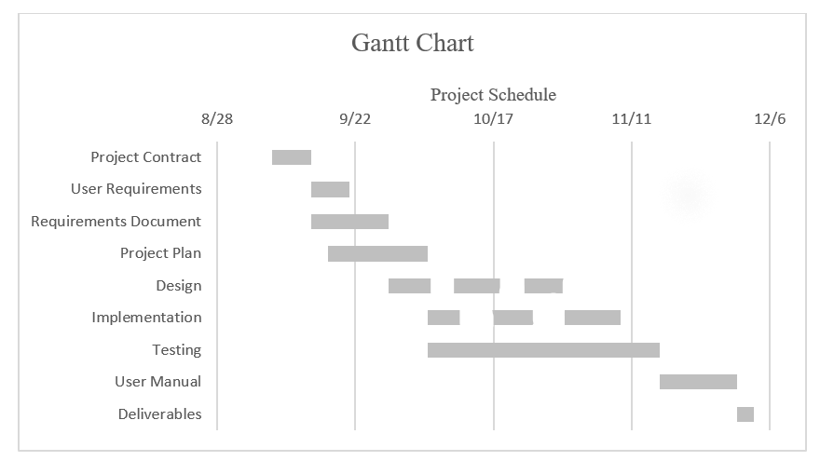
Timeline

Slide 11
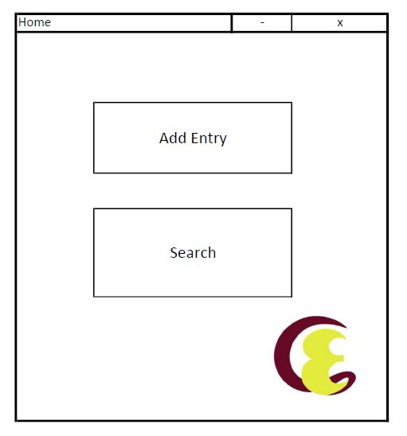
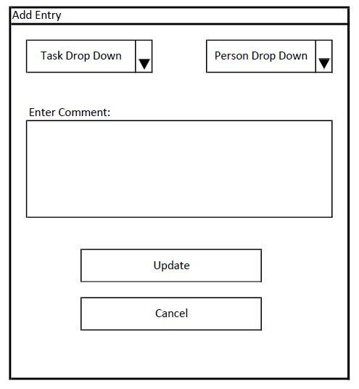
User Interface

Slide 12
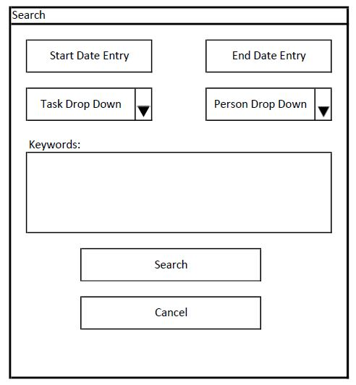
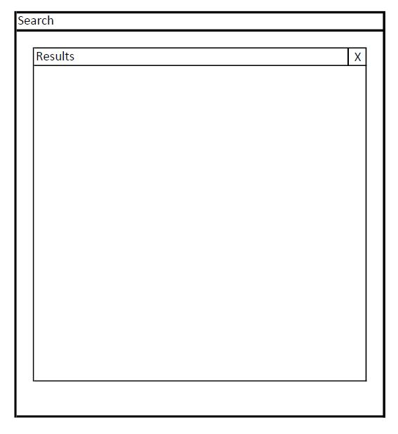
User Interface

Slide 13
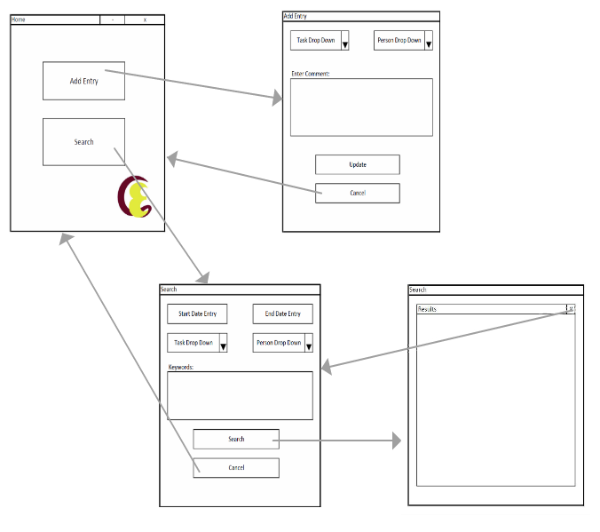
Navigation Diagram

Slide 14
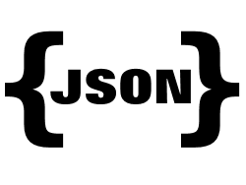
Data Design
JSON
Unique Time Stamp:
Task Type:
Person:
Comment:

Slide 15
Future Goals
Two more design diagrams to complete
Begin implementation and testing phases, already behind
Utilize the Handwriting Recognition Software on the S3

